Slide 1
Metal and polymer fume fever
Robert Hendrickson, MD

Slide 2
Case # 1
32 yo man welding galvanized steel pipes
Monday after a one-week vacation
That evening, he develops fever, chills, myalgias, headache which continue overnight.
He comes to work Tuesday morning with continued symptoms
  Diagnosis?

Slide 3
Case # 1
32 yo man welding galvanized steel pipes
Monday after a one-week vacation
That evening, he develops fever, chills, myalgias, headache which continue overnight.
He comes to work Tuesday morning with continued symptoms
  Metal fume fever
  From inhalational exposure to zinc while welding galvanized steel

Slide 4
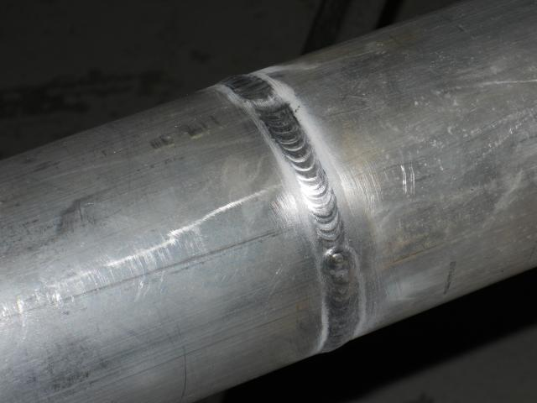
What is welding?

Slide 5
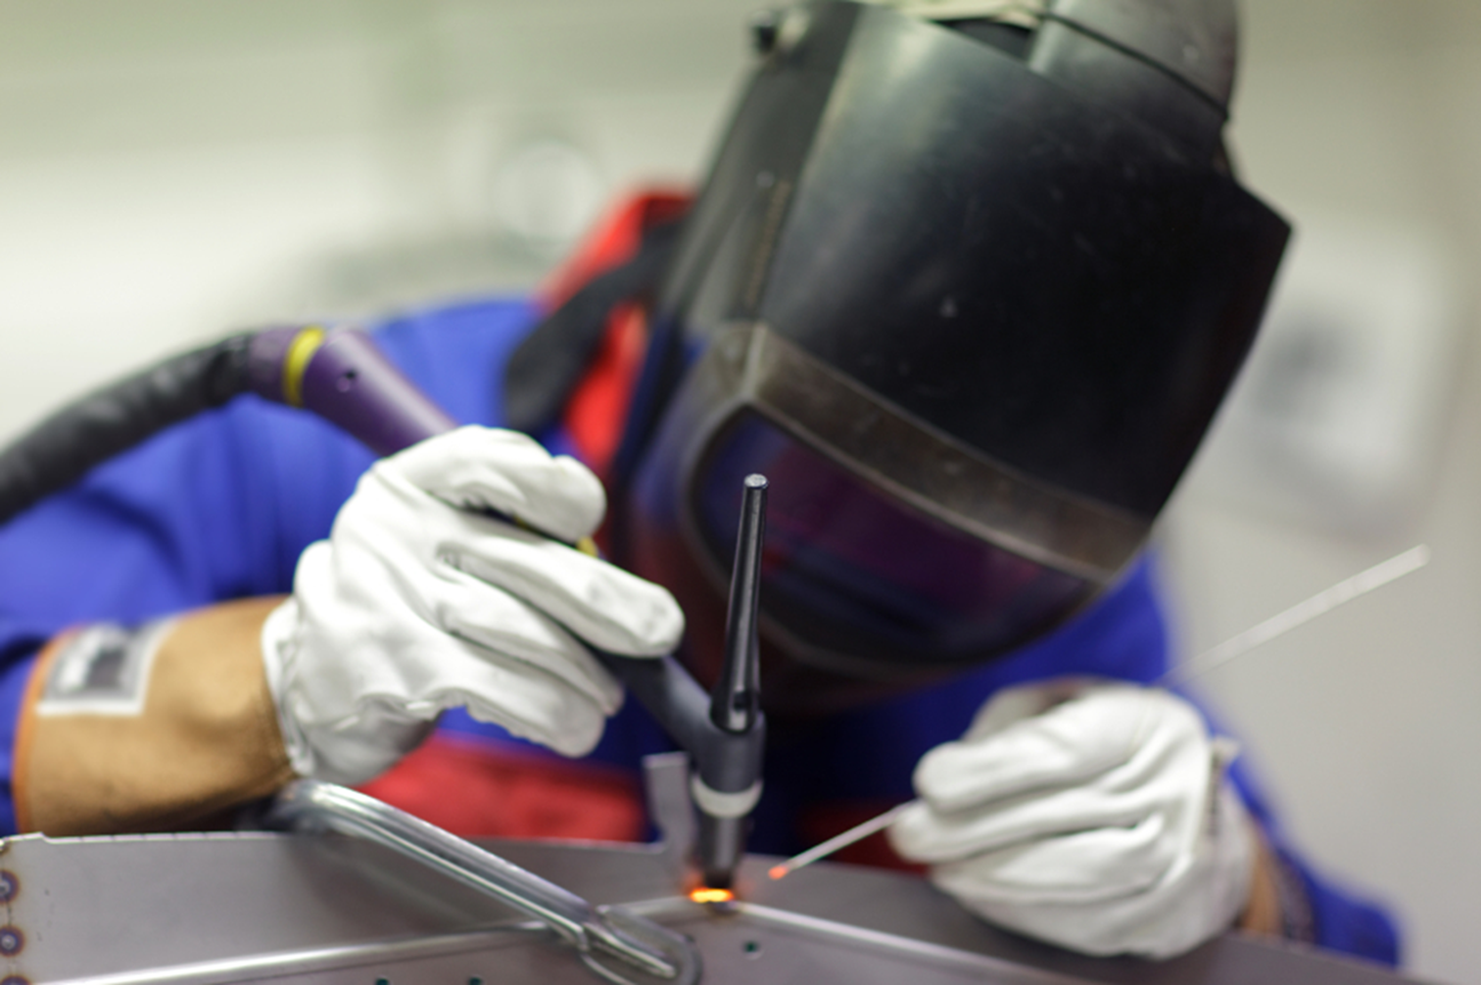
What is welding?
Joining pieces of metal together
  Melting both metals
Requires:
  Heat
  Filler metal
  Base metal

Slide 6
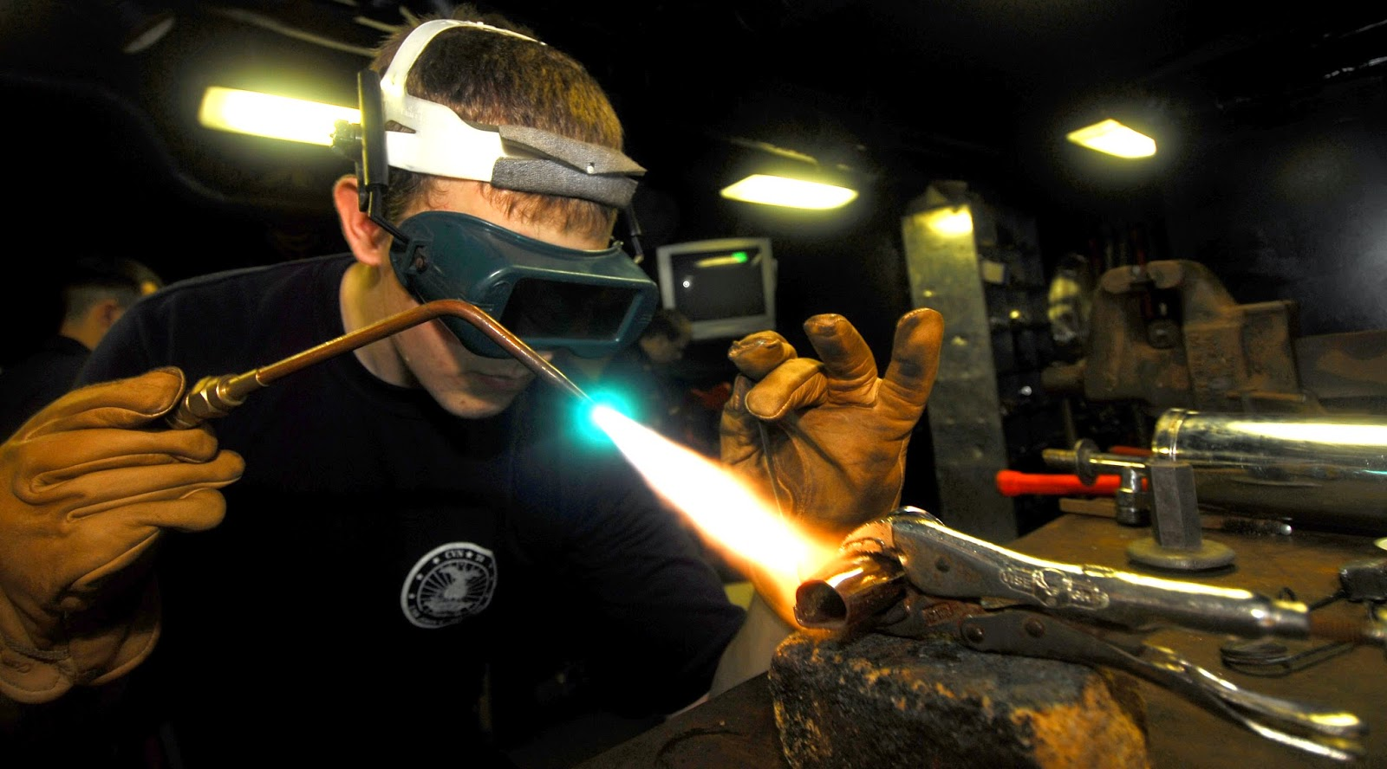
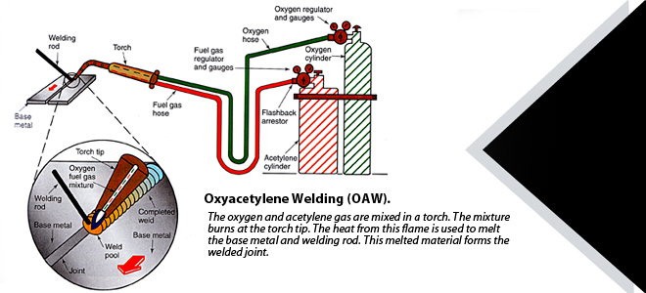
Types of welding
Gas welding
  Oxy-acetylene

Slide 7
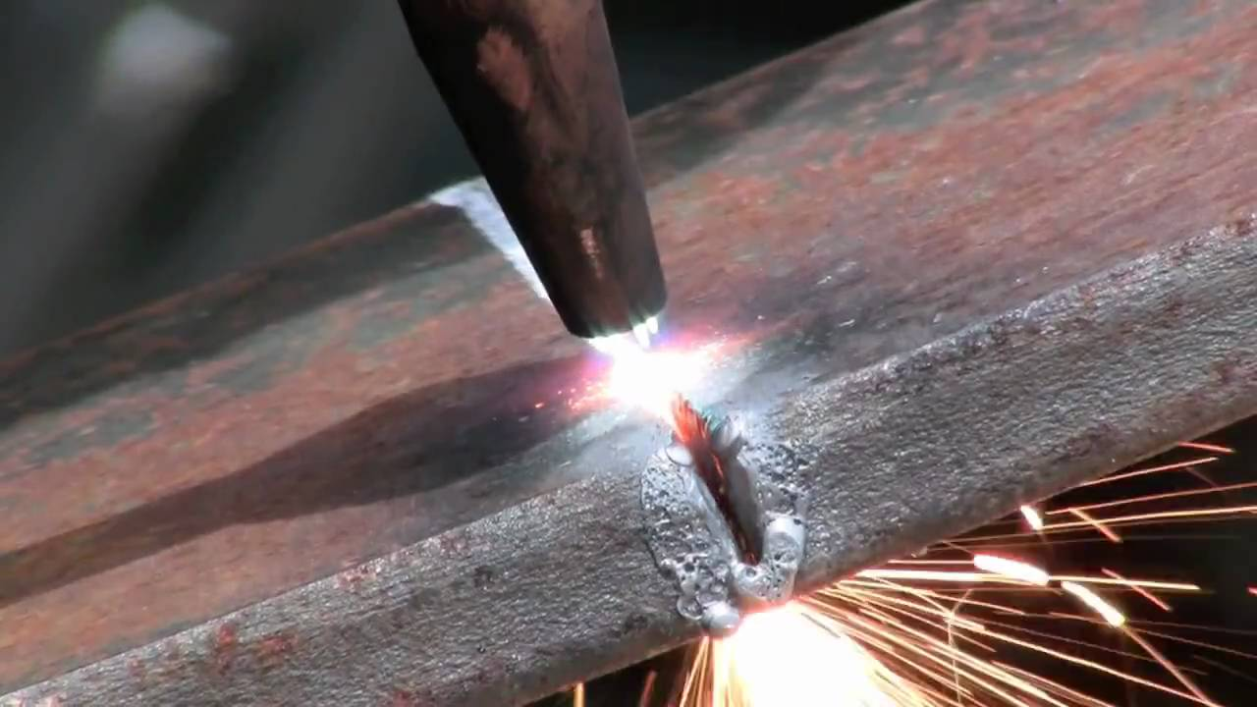
Types of welding
Gas welding
  Oxy-acetylene
  Cutting – high velocity oxygen

Slide 8
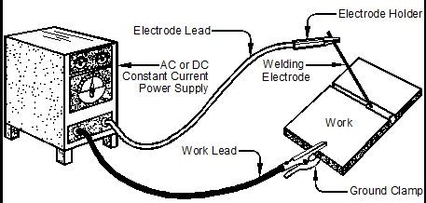
Types of welding
Arc welding

Slide 9
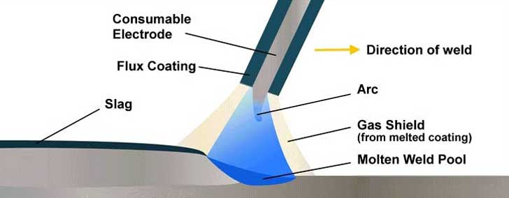
Types of welding
Arc welding
  Manual metal arc welding (MMA); stick welding
    Consumable stick electrode

Slide 10
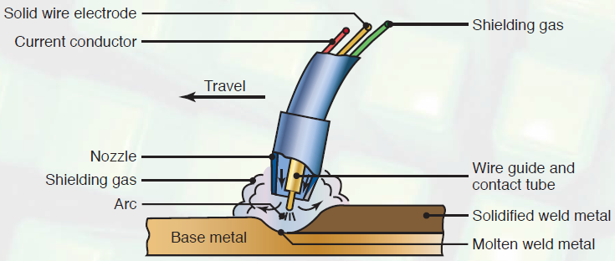
Types of welding
Arc welding
  Manual metal arc welding (MMA); stick welding
  Gas metal arc welding
    Metal inert gas (MIG)
    Tungsten inert gas (TIG)

Slide 11
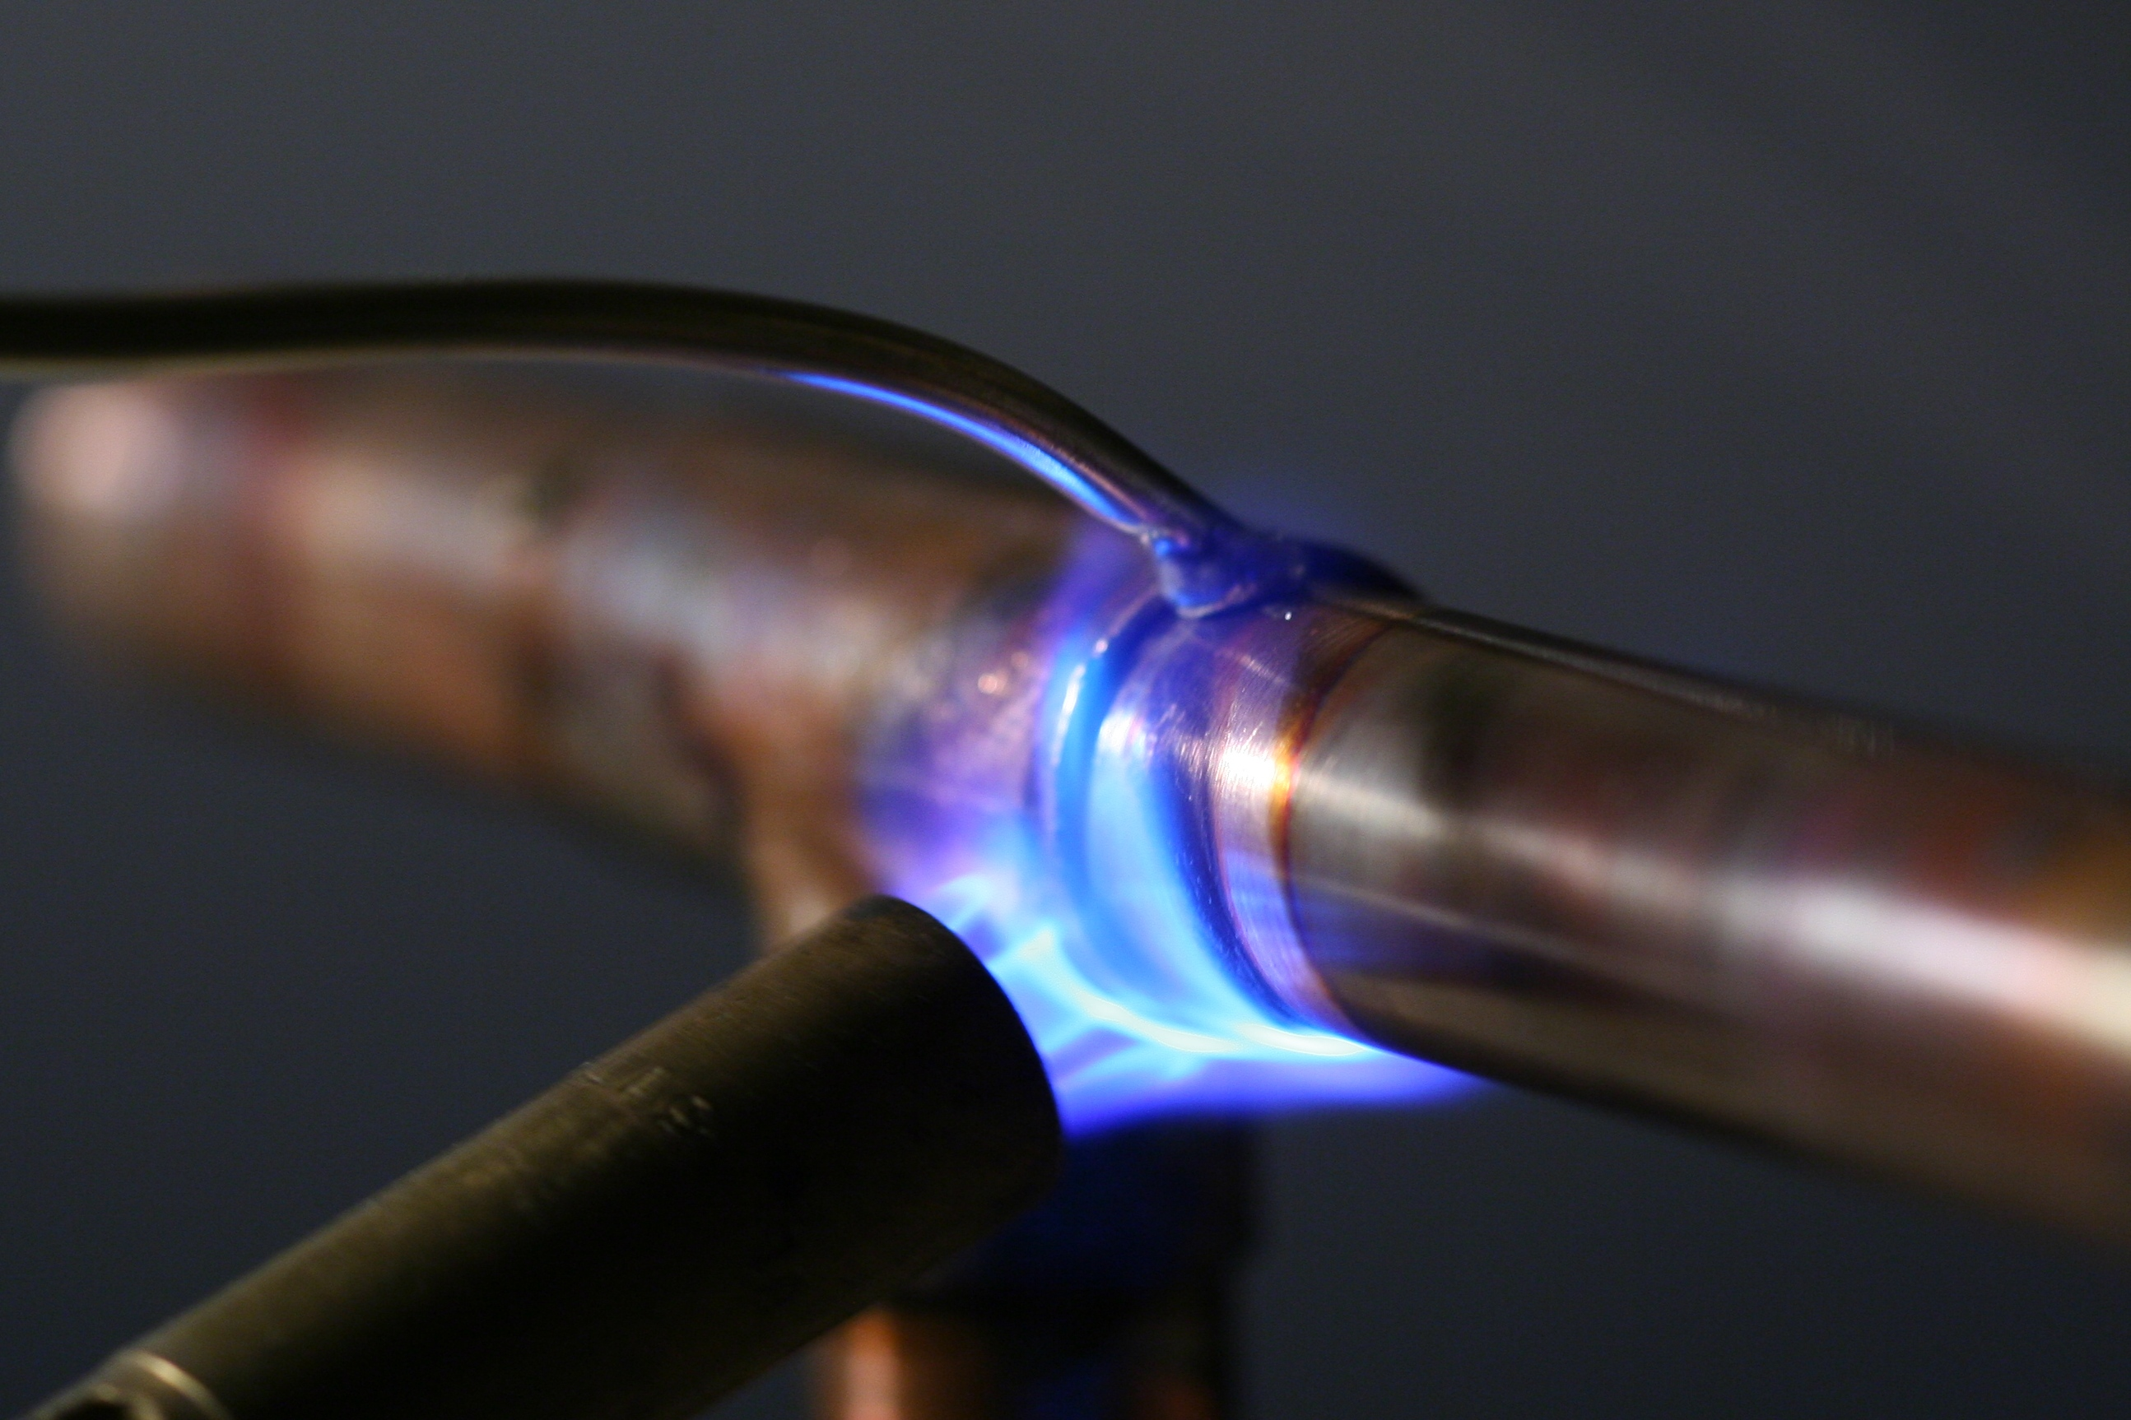
Joining methods
Lower temperature processes:
  Soldering
  Brazing
Notes:
Soldering < 450C
Brazing > 450C
Copper pipes are commonly soldered.

Slide 12
Joining methods
  Filler metal:
  Soldering
    Tin/lead(Sn/Pb)
    Tin with
      Nickel
      Bismuth
      Antimony
      Silver
  Brazing
    Copper
    Phosphorous
    Silver
Notes:
Soldering < 450C
Brazing > 450C
Copper pipes are commonly soldered.

Slide 13
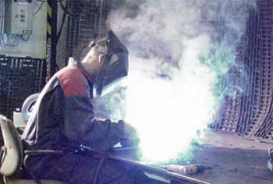
Exposures associated with welding
Inhalational
Welding plume
  Metal fumes

Slide 14
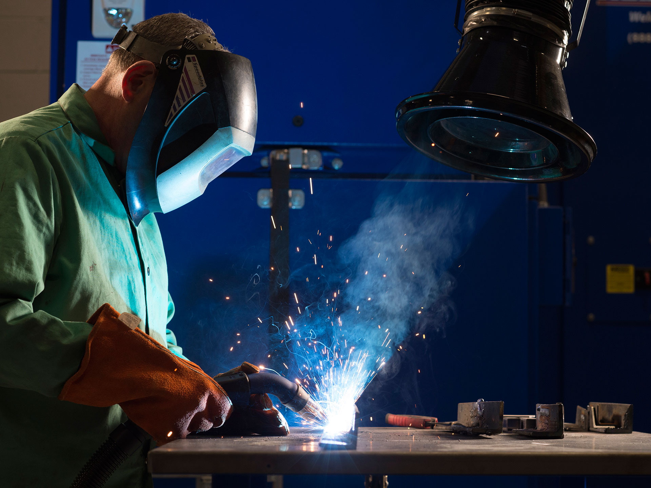
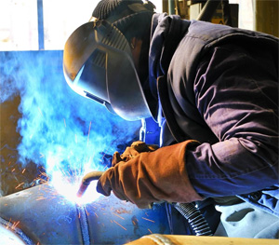
Exposures
Fume = solid particles produced by condensation of vapors or gases
  Vaporized metals that form solid metal oxides
  Typically less than 1.0 um in diameter

Slide 15
Welding metal exposures
Steel – mostly iron oxide with additive metals
  Nickel, chromium, manganese, molybdenum, vanadium, titanium, cobalt, copper
Stainless steel – chromium, nickel, and iron
Coatings:
  Galvanized steel – zinc
  Cadmium plating
  Paints - lead oxide
Filler rods – lead, copper, zinc, silver, cadmium, magnesium, manganese

Slide 16
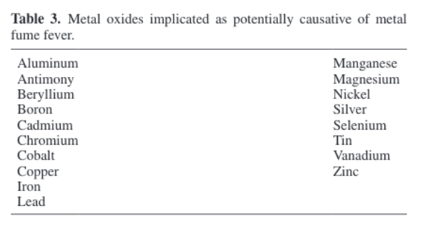
Metal fume fever
Causes of MFF: Zinc oxide

Slide 17
Metal fume fever
“welder’s ague”
“brass chills”
“zinc fever”, “zinc fume fever”
“copper fever”, “foundry fever”
“smelter’s shakes”, “metal shakes”
“smelter’s chills”, “zinc chills”

Slide 18
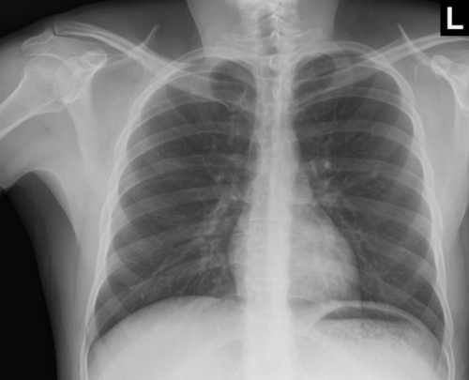
Metal fume fever
Symptoms: Delayed onset (4-10 hours after cessation of exposure)
  Influenza-like illness
    Fever(60%), chills(29%)
    Arthralgias, myalgias(22%)
    Headache(27%)
    Malaise(16%), fatigue
    Less common:
      Cough, pleuritic chest pain, dyspnea
      Abdominal pain, nausea, vomiting
Notes:
1974 – 31% of welders reported getting MFF

Slide 19
Metal fume fever
Signs:
  Fever
  Tachycardia
  Pulse oximetry = normal
  Respiratory rate = normal
  Chest: normal
    May have mild rales or wheezing
Notes:
1974 – 31% of welders reported getting MFF

Slide 20
Metal fume fever
Chest X-ray = normal
Resolves
  12-48 hours
Notes:
1974 – 31% of welders reported getting MFF

Slide 21
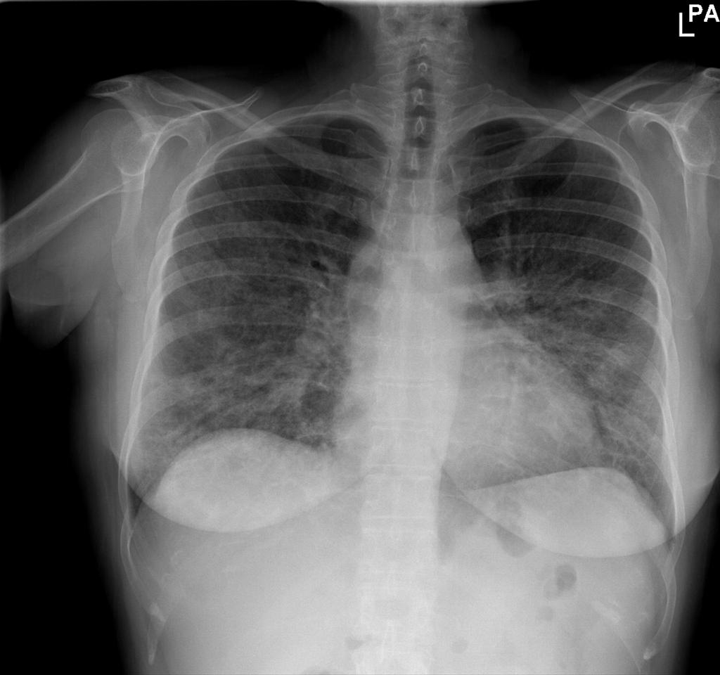
Metal fume fever
Rare, severe forms of metal fume fever are likely to be cases of:
  Cadmium pneumonitis
  Zinc chloride smoke (military smoke)
Hypoxemia
Abnormal CXR
Notes:
CT =

Slide 22
Metal fume fever
Estimated 1500-2500 cases per year in the US
Australian study:
  96% men
  99% adults
  53% occupational
  46% home / workshop welding
  Monday most common (24%)
    Aust Fam Physician 2012; 41: 141-3
  Many do not seek care (25-30% of PC calls are seen in a healthcare setting)
    Clin Toxicol 2015; 53(4): 195-203

Slide 23
Metal fume fever
Pathophysiology:
  Exposure to high concentrations of zinc (or other metal): > 100 mg Zn/m³
  Zinc must be freshly oxidized
    Aerosolized zinc oxide does not cause MFF
    Freshly oxidized zinc particle size is “nanoparticle size” whereas zinc oxide powder is larger.
Notes:
1974 – 31% of welders reported getting MFF

Slide 24
Metal fume fever
Causes:
  Zinc (& other metals) lead to
    Increases in inflammatory mediators (IL-6, IL-8, TNF), ~3h after exposure (human volunteer studies)
    Neutrophil and macrophage activation (8-22h after exposure)
      Leads to release of more pyrogenic inflammatory mediators
      Zinc directly activates neutrophils/macrophages in vitro
Notes:
1974 – 31% of welders reported getting MFF

Slide 25
Metal fume fever
Causes: (not metal fume fever)
  Delayed hypersensitivity
    Urticaria and angioedema
    Persistent (4wk) obstructive pulmonary dysfunction
    Sensitization
    Hapten/zinc-protein conjugate serve as antigens
    Bronchoalveolar lavage fluid = neutrophils
  Not consistent with metal fume fever & is likely rare zinc hypersensitivity pneumonitis
Notes:
1974 – 31% of welders reported getting MFF

Slide 26
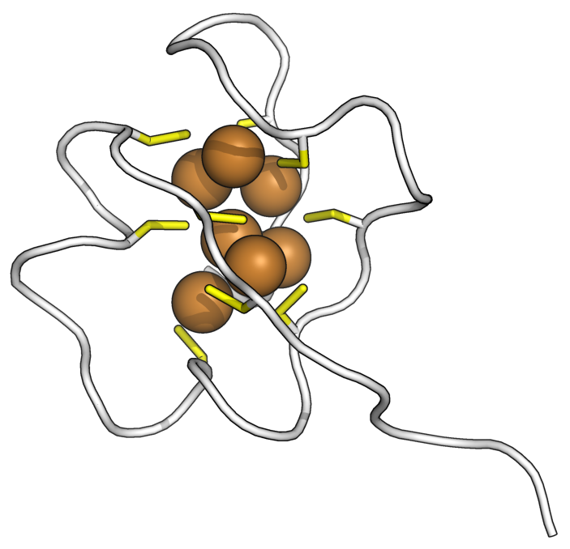
Metal fume fever
Tachyphylaxis
  Symptoms are less on consecutive exposures, most on Mondays after a weekend hiatus
  Possibly due to release of “stress proteins”, such as metallothionein.
    Animal model- zinc oxide fumes increased expression of metallothionein and heme oxygenase mRNA
    Metallothionein binds zinc
Notes:
Metallothionein – LMW cysteine-rich cytosolic protein associated with the golgi apparatus that can bind to many metals. 1 metallothionein can bind 7 atoms or Zn or Cd. Metallothionein binds to zinc, copper, selenium, cadmium, mercury, silver, arsenic.

Slide 27
Cadmium pneumonitis
Copper soldering/brazing
Cadmium-containing filler rods
Initially looks like metal fume fever
Then, develop pneumonitis
20% develop fibrosis
  Pulmonary function tests =
    Restrictive pattern
Notes:
1974 – 31% of welders reported getting MFF

Slide 28

Chemical pneumonitis
Cadmium
Other irritants:
  Ozone
  Nitrogen dioxide
Notes:
1974 – 31% of welders reported getting MFF

Slide 29
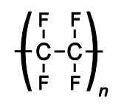

Polymer fume fever
Notes:
1974 – 31% of welders reported getting MFF

Slide 30
Polymer fume fever
Teflon (polytetrafluoroethylene)
PFF first described in 1951, shortly after the commercialization of Teflon (1946)
Teflon > 300ºC
Notes:
1974 – 31% of welders reported getting MFF

Slide 31
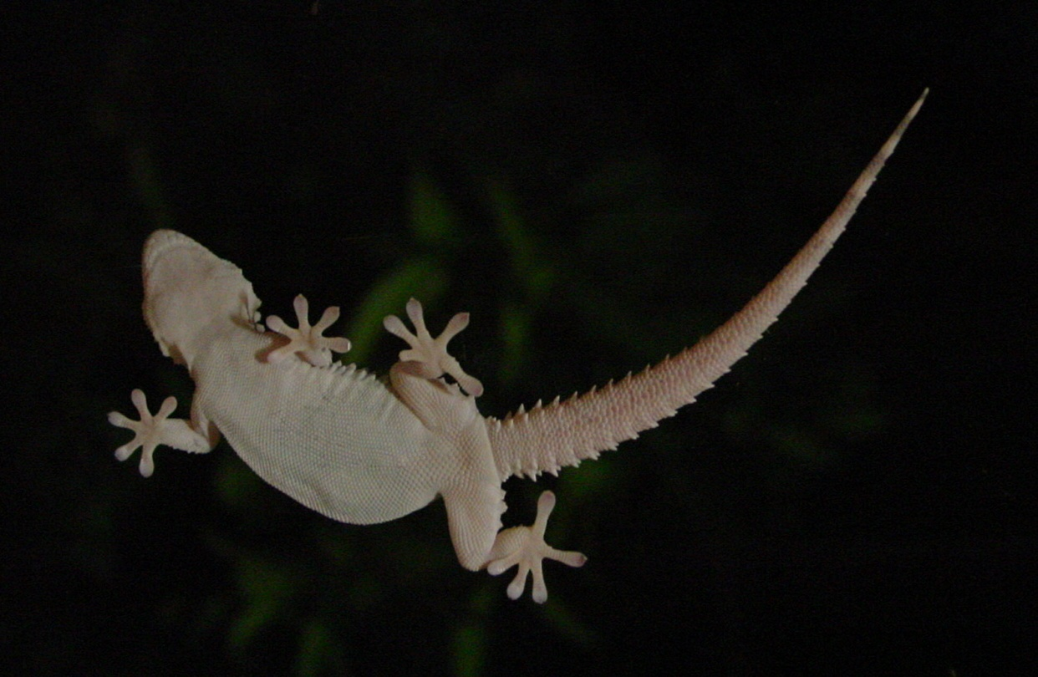

Teflon
Plastic with the lowest coefficient of friction
  Non-stick pans
Notes:
Teflon’s resistance to Van der Waals forces make it the only known substance to which Gecko’s cannot stick.

Slide 32
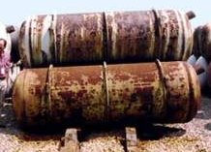
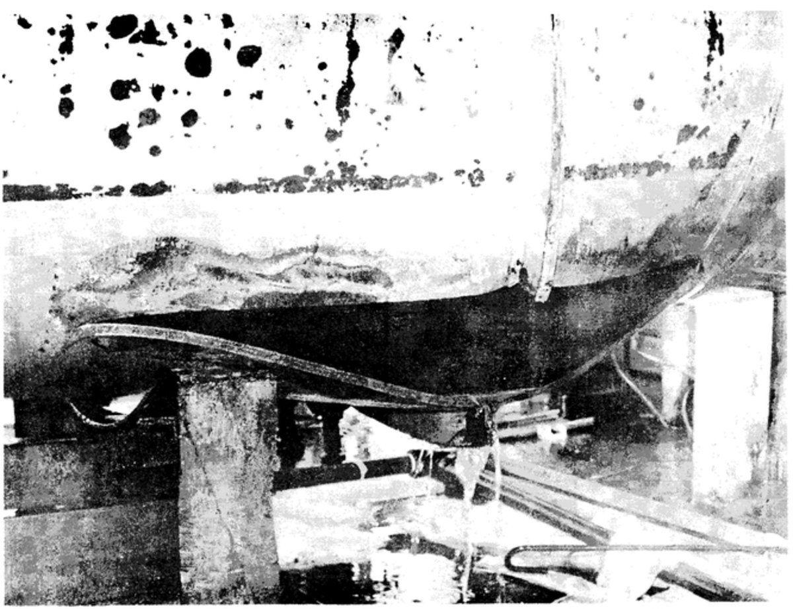
Teflon
Non-reactive
  Pipes & containers for reactive chemicals
    Early use to line containers holding highly reactive uranium hexafluoride that is used in the uranium enrichment process
Notes:
Uranium hexafluoride is the “depleted uranium” from uranium enrichment. It combines with water to form uranium fluoride and hydrogen fluoride which are highly corrosive. When placed in steel containers (shown in image), they corrode over decades.
Uranium hexafluoride corroding a steel vessel was the cause of one fatality and 12 injuries in Gore, OK (Sequoya Fuels Corporation) – image on the right.
Uranium hexafluoride is now being converted to solid uranium oxides for safer storage.

Slide 33
Teflon
Other uses:
  Ski bindings (anti-friction device)
  Sports/outdoor apparel (waterproofing)
  Pyrotechnic, oxidizer, flares, solid-fuel rocket
  Plumbing – thread seal tape
  Industrial air filters
  Bicycle lubricants/greases (hub bearings)
  3D printers (Bowden tubing)
  PTFE sheets in production of butane hash oil (BHO)

Slide 34
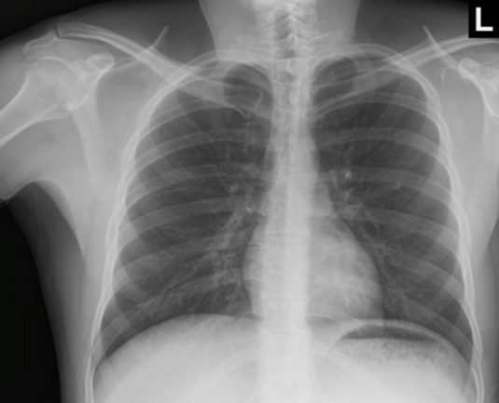
Polymer fume fever
Rare
  9 cases reported to US PCs / year
~10-15% seen in healthcare facility
  Clin Toxicol 2015; 53(4): 195-203
  Am Ind Hyg Assoc J 1974; 35: 99-106
Notes:
1974 – 31% of welders reported getting MFF

Slide 35
Polymer fume fever
Pyrolyzed Teflon (polytetrafluoroethylene)
Similar to MFF
  Delayed onset (4-10 hours)
  Flu-like symptoms
    Chest tightness(86%),
    Fever(55%), chills(61%)
    Shortness of breath(72%), cough(61%)
    Sore throat(17%)
Notes:
1974 – 31% of welders reported getting MFF

Slide 36
Polymer fume fever
Signs:
  Tachycardia
  Fever
  Pulse oximetry = normal
  Respiratory rate = normal
Chest xray = normal
Resolves over 12-48 hours
Notes:
1974 – 31% of welders reported getting MFF

Slide 37
Polymer fume fever
Pathophysiology - unelucidated
  Decomposition products of PTFE:
    Octafluoroisobutylene
    Difluoroethylene
    Hexafluoroethane
    Hexafluoropropylene
    Octafluorocyclobutane
  Lead to inflammatory reaction
  Exact pathway unclear
Notes:
1974 – 31% of welders reported getting MFF

Slide 38
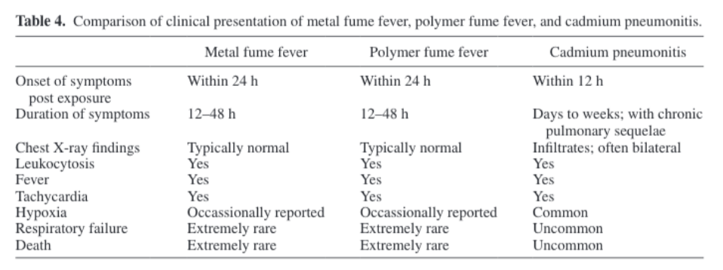
MFF v. PFF v. Cadmium pneumonitis
Notes:
1974 – 31% of welders reported getting MFF

Slide 39
Case
22 year old man
Cutting apart an old industrial air filter – metal coated with teflon
Developed fever, chills, headache, myalgias, and arthralgias 8 hours after work
Work up?
  Diagnosis is clinical
Notes:
1974 – 31% of welders reported getting MFF

Slide 40
Case
Work up?
  Labs? Not necessary.
    CBC – may show leukocytosis
    ESR/CRP elevated
    Zinc – serum or urine elevated
      Not readily available
      Not necessary for diagnosis
  Chest xray
    To rule out other disorders (e.g. pneumonia, cadmium pneumonitis, hydrocarbon pneumonitis)
  Pulmonary function testing
    May have decreased vital capacity while symptomatic
    Not necessary
Notes:
1974 – 31% of welders reported getting MFF

Slide 41
Case
Treatment?
  Antipyretics/anti-inflammatories
    NSAIDS, acetaminophen
  Severe cases with wheezing, ALI, hypoxemia
    Bronchodilators, corticosteroids, ventilatory support
  Supportive care
Notes:
1974 – 31% of welders reported getting MFF

Slide 42
Prevention
Workplace evaluation
  Occupational physician and industrial hygienist
  Potential:
    Personal work space sampling for metals or fluorocarbon polymer decomposition products
    Measurement of nitrogen dioxide, carbon monoxide
    Airflow and ventilation assessment
    Use and fit of personal protective equipment
Most effective interventions are engineering controls rather than PPE (rely on compliance)
Notes:
1974 – 31% of welders reported getting MFF

Slide 43
Prognosis
Most cases of MFF and PFF resolve within 12-48 hours
Extremely rare case reports of MFF and PFF with: (these may be cases of pneumonitis)
  Obstructive pulmonary disease
  Pulmonary fibrosis
  Decreased pulmonary diffusing capacity

Slide 44
Occupational monitoring
Depends on the likely exposure
Initial
  History, physical examination
  Cadmium:
    Initial UCd, BCd, beta2 microglobulin
    At least annual
  Zinc:
    Initial CXR and PFTs
    At least annual
Notes:
1974 – 31% of welders reported getting MFF

Slide 45
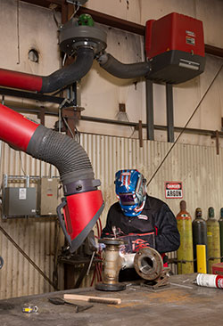
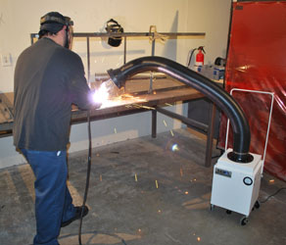
Occupational safety
US OSHA requires “Hazard Communication” for all employees who weld
  Worker position to avoid inhalation, e.g upwind
  Ventilation – outdoors, exhaust systems
Notes:
1974 – 31% of welders reported getting MFF

Slide 46
Occupational safety
OSHA requires “Hazard Communication” for all employees
  Worker position to avoid inhalation, e.g upwind
  Ventilation – outdoors, exhaust systems
  Respiratory protection
    If airborne concentrations are above action levels set by OSHA
Notes:
1974 – 31% of welders reported getting MFF

Slide 47
Occupational safety
After acute exposure
  No confirmatory testing is recommended
  Urinary zinc concentrations may be elevated
  Urinary fluoride concentrations may be elevated
    These are only signs of inhalation
      Should initiate an investigation (all cases of MFF or PFF should initiate an investigation
    NOT diagnostic of MFF or PFF
Notes:
1974 – 31% of welders reported getting MFF

Slide 48
Conclusions
Metal & Polymer fume fever
  Delayed (4-12h) influenza-like symptoms
    Fever, chills, headache, myalgias, cough
  Chest xray is normal
  Resolves in 12-48 hours
  Tachyphylaxis (worst on mondays)
  Should initiate a workplace investigation to reduce risk of future exposure
Notes:
1974 – 31% of welders reported getting MFF

Slide 49
Conclusions
Metal & Polymer fume fever
  If severe form with xray findings
    Likely not MFF or PFF
    Consider
      Cadmium pneumonitis
      Pneumonitis from nitrogen dioxide or ozone
Notes:
1974 – 31% of welders reported getting MFF

Slide 50


Questions and discussion…

